Slide 1
CSS Basics

Slide 2

Agenda
What is CSS Media Queries ?
Advantages of CSS Media Queries
How to use
References
Demo
2/2/2013
<number>

Slide 3

What is CSS Media Queries ?
CSS Media Queries are a feature in CSS3 which allows you to specify when certain CSS rules should be applied. This allows you to apply a special CSS for different screen devices with at least one expression:
Large desktop
Portrait tablet to landscape and desktop
Landscape phone to portrait tablet
Landscape phones and down
…
2/2/2013
<number>

Slide 4
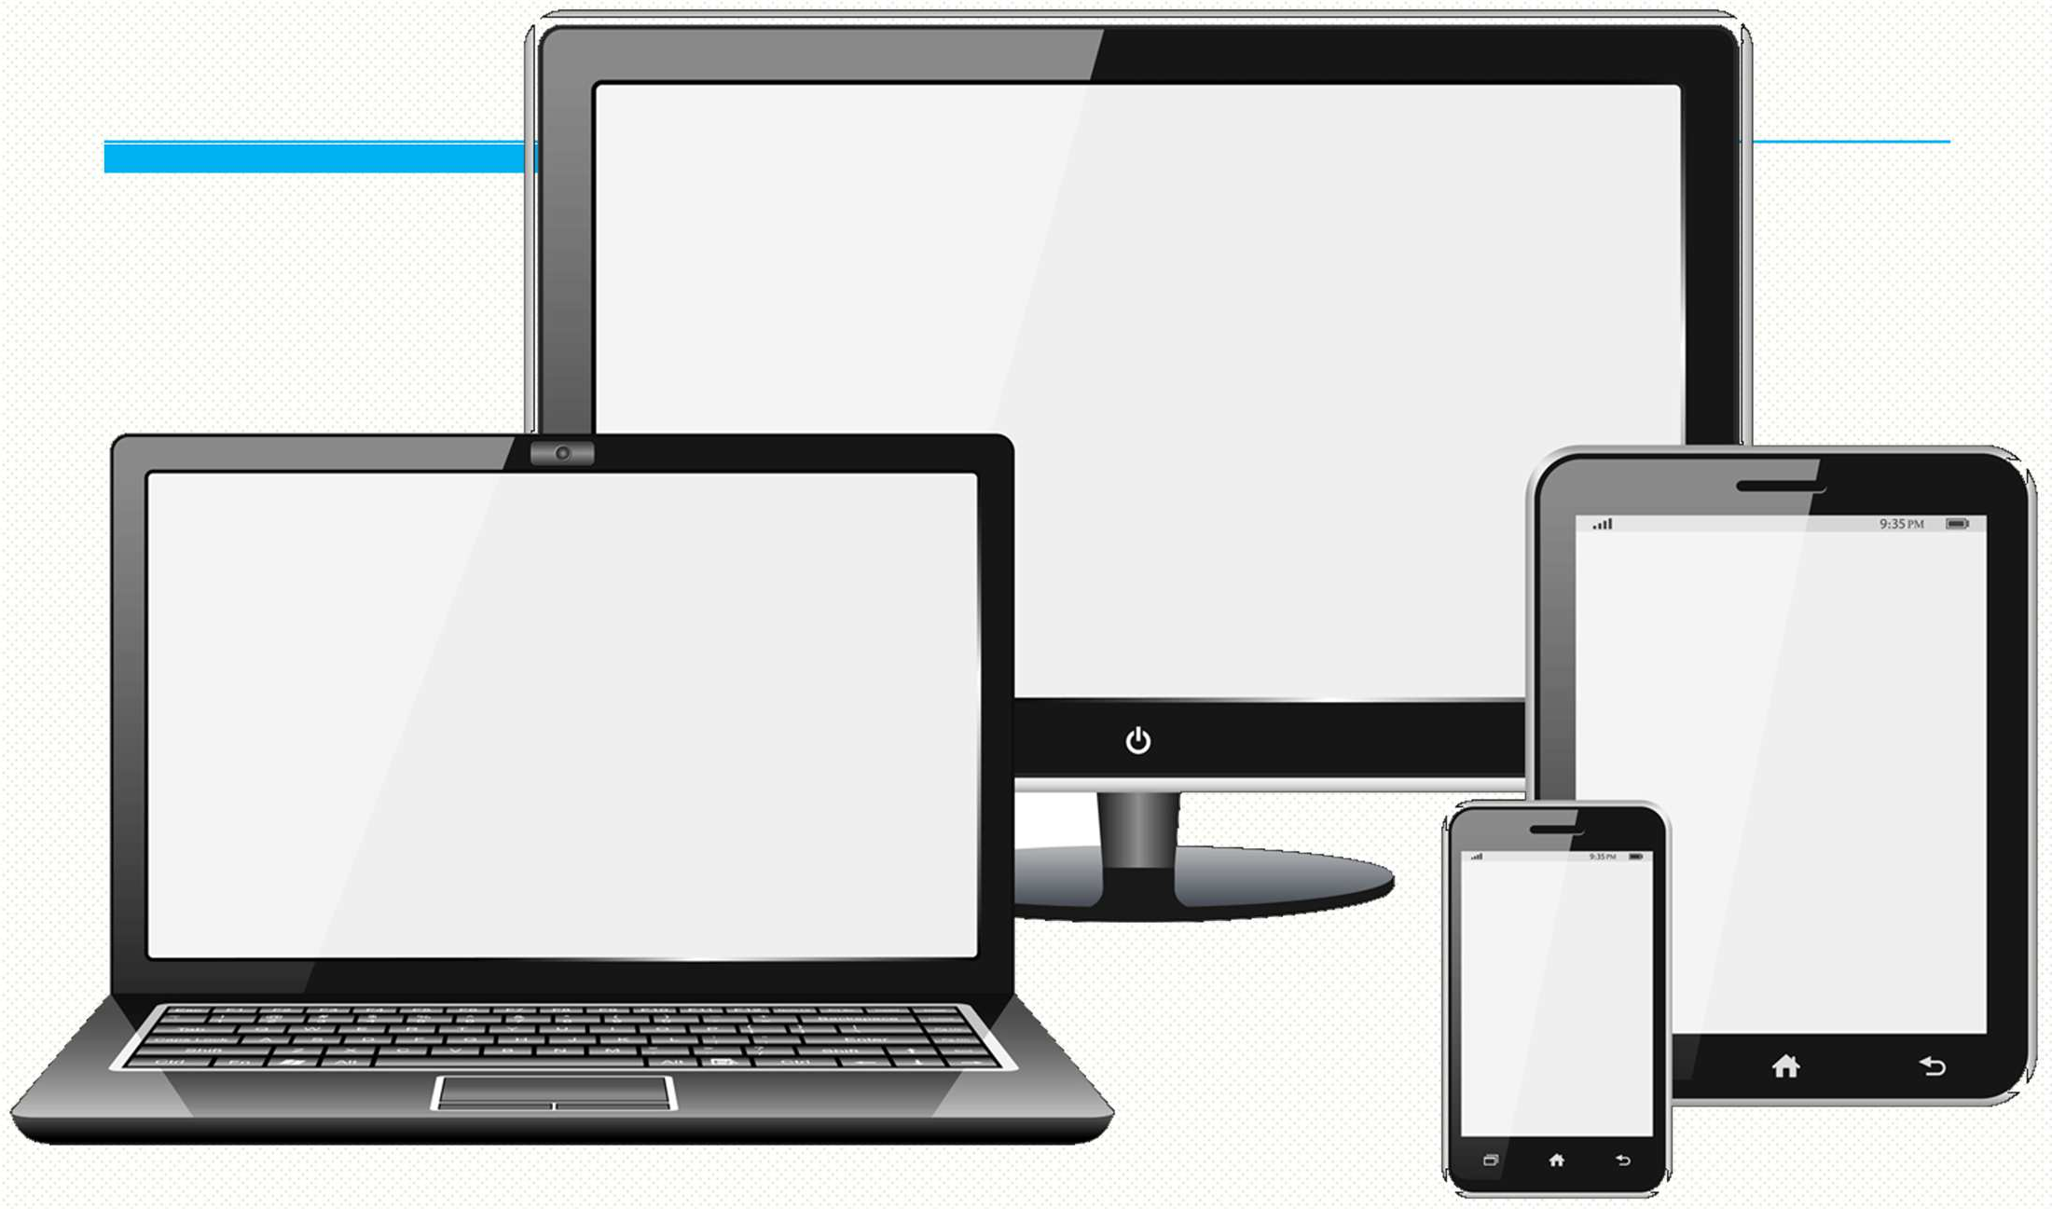
2/2/2013
4

Slide 5

Advantages
Only valid CSS will be loaded
Web Responsive Design
Adjust print layout
Decrease using JavaScript to load page and detect screen
…
2/2/2013
<number>

Slide 6

How to use (1/2)
/* Large desktop */
@media (min-width: 1200px) { ... }
/* Portrait tablet to landscape and desktop */
@media (min-width: 768px) and (max-width: 979px) { ... }
/* Landscape phone to portrait tablet */
@media (max-width: 767px) { ... }
/* Landscape phones and down */
@media (max-width: 480px) { ... }
<number>

Slide 7

How to use (2/2)
<link rel="stylesheet" media="(max-width: 800px)" href=“style.css" />
<link rel=“stylesheet” media=“screen and (min-width: 701px) and (max-width: 900px)” href=“style.css” />
More …
2/2/2013
<number>

Slide 8

Useful tips
If you are using Internet Explorer 6,7,8: include this into html <head>
<!--[if lt IE 9]>
<script src="http://css3-mediaqueries- js.googlecode.com/svn/trunk/css3-mediaqueries.js"></script>
<![endif]-->
Responsive Design
<meta name="viewport" content="width=device-width, initial-scale=1.0" />
2/2/2013
<number>

Slide 9
How to create Web Layout?

Slide 10
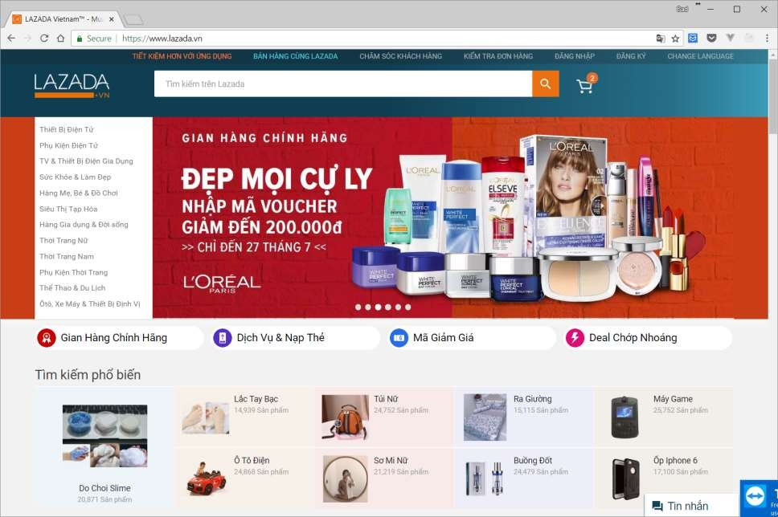
Header
Navigation & Banner
Content

Slide 11
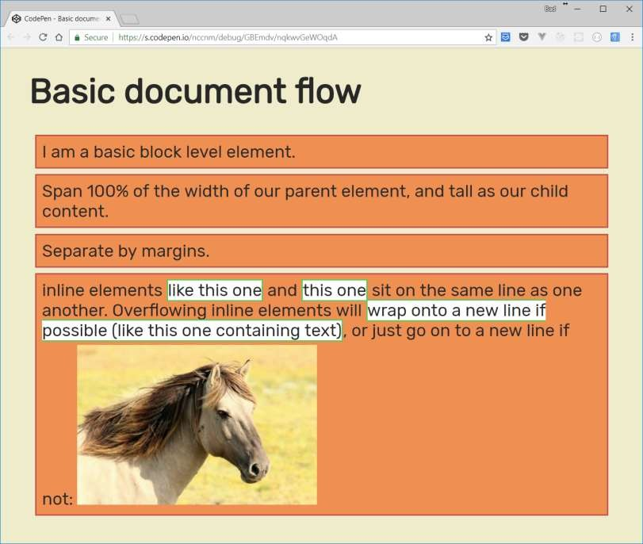
Normal flow
<h1>Basic document flow</h1>
<p>...block element…</p>
<p>Span 100% of the width of our parent element...</p>
<p>Separate by margins...</p>
<p>…<img src=“…”></p>

Slide 12
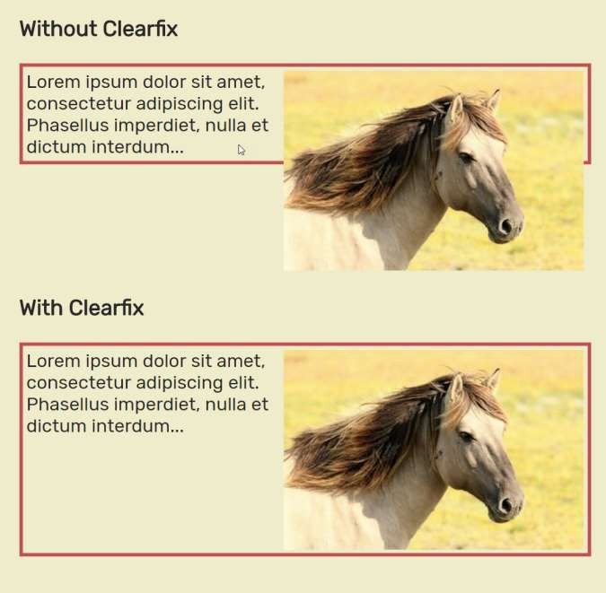
Float and clear
.img2 {
float: right;
}
.clearfix::after { content: ""; clear: both; display: table;
}
<div class="clearfix">
<img class="img2"...></img>
</div>

Slide 13
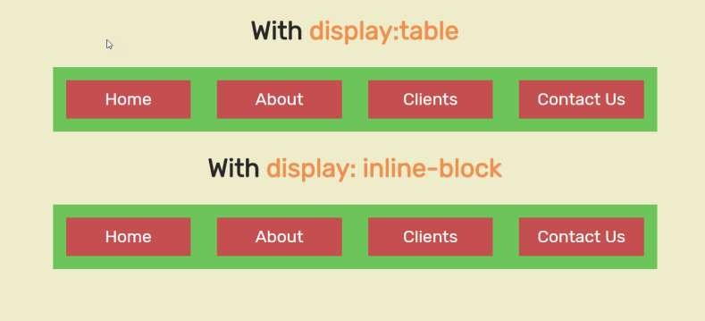
Table layout
HTML Table and CSS Table.
.nav-table {
display: table;
...
}
<nav class="nav-table">
<ul>
<li><a href="#">Home</a></li>
<li><a href="#">About</a></li>
<li><a href="#">Clients</a></li>
<li><a href="#">Contact Us</a></li>
</ul>
</nav>

Slide 14
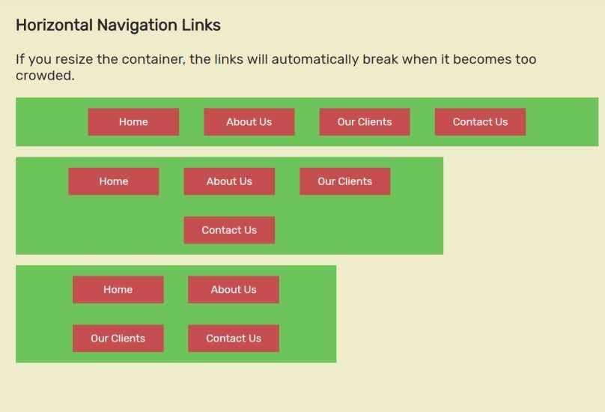
inline-block
.nav li {
display: inline-block; font-size: 20px;
padding: 20px;
}

Slide 15
Flexbox

Slide 16
Agenda
What is Flexbox?
Flexbox container
Flexbox item
Summary

Slide 17
What is flexbox actually?
Flexbox is a new module in CSS3 that makes it easy to align elements to one another, in different directions and orders;
The main idea behind flexbox is to give the container the ability to expand and to shrink elements to best use all the available space;
Flexbox replaces float layouts, using less, and more readable and logical code;
Flexbox completely changes the way that we build on- dimensional layouts;

Slide 18
Flexbox properties overview
Container
flex-direction: row | row-reverse
Item
align-self: auto | stretch |flex-start
| flex-end | center | baseline
order: 0 | <interger>
flex-grow: 0 | <interger>
flex-shrink: 0 | <interger>
5
flex-basic: auto | <len>
flex: 0 1 auto | <int> <int> <len>
| column | column-reverse
1
1
flex-wrap: wrap | no-wrap | wrap-reverse
2
2
justify-content: flex-start |
flex-end | space-between |
space-around | space-evenly
3
3
4
align-items: stretch | flex-start | flex-end | center | baseline
4
5
align-content: stretch | flex-start
| flex-end | center | space-between |space-around

Slide 19
Flexbox container

Slide 20
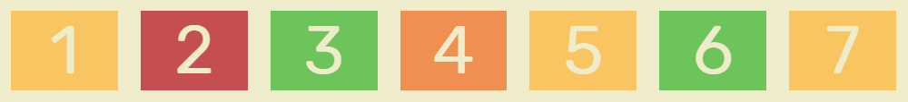
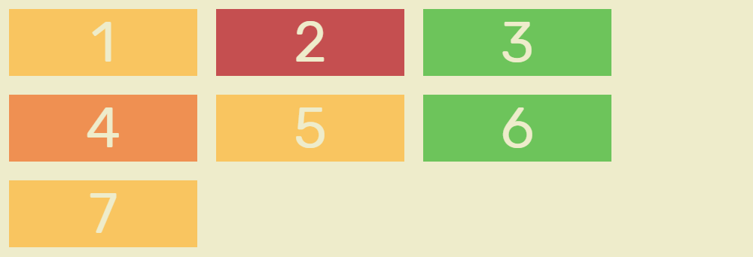
flex-wrap
flex-wrap: nowrap | wrap | wrap-reverse
Main Axis
nowrap
wrap
Cross Axis

Slide 21
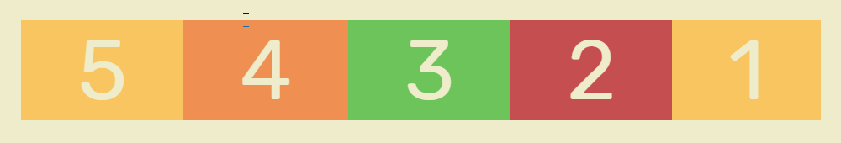
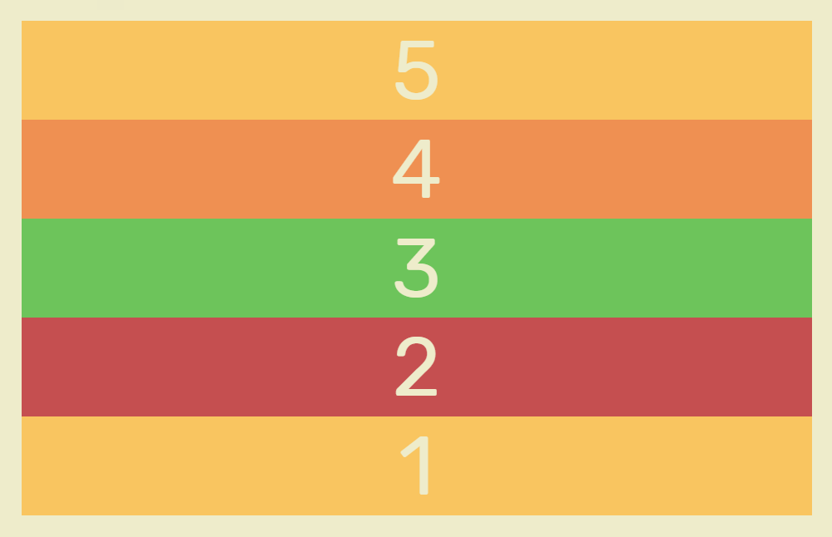
flex-direction
flex-direction:
row | row-reverse | column | column-reverse
.containter {
display: flex;
flex-direction: column-reverse;
}
<div class="containter">
<div>1</div>
<div>2</div>
<div>3</div>
<div>4</div>
<div>5</div>
</div>

Slide 22
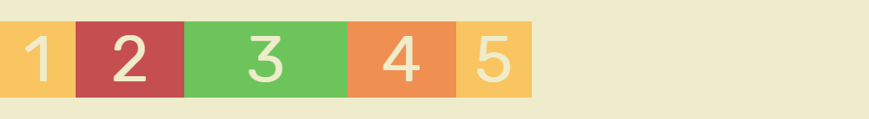
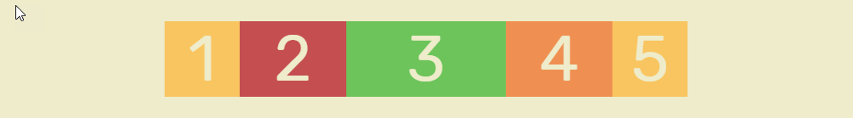
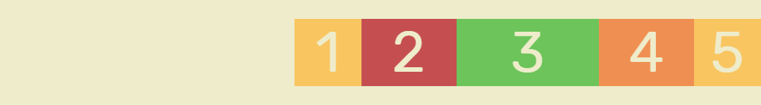
justify-content
justify-content: flex-start | flex-end | space-between | space-around |space-evenly
Main Axis
flex-start
center
flex-end

Slide 23

justify-content: space-between
justify-content: flex-start | flex-end | space-between | space-around |space-evenly
Main Axis
x
x
x
x
space-between

Slide 24
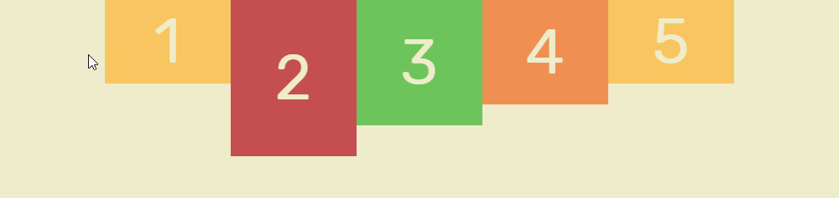
align-items: flex-start
align-items: stretch | flex-start | flex-end | center | baseline
Main Axis
Cross Axis
flex-start

Slide 25
Flexbox item

Slide 26
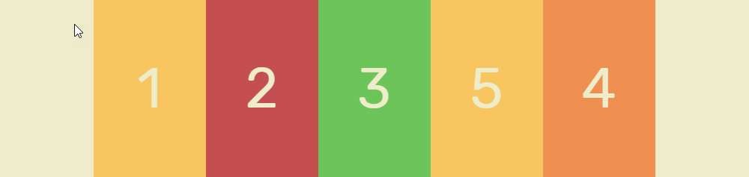
order
order: 0 | <interger>
Main Axis
0
0
0
0
.item4 {
order: 1;
}

Slide 27
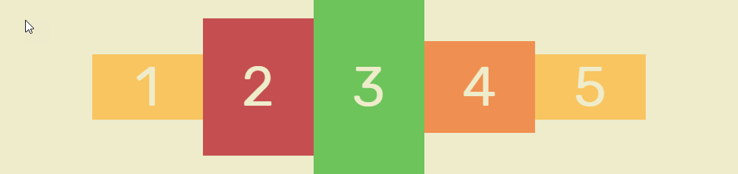
align-self: stretch
align-self: auto | stretch |flex-start | flex-end | center | baseline
Main Axis
Cross Axis
.item3 {
align-self: stretch;
}

Slide 28
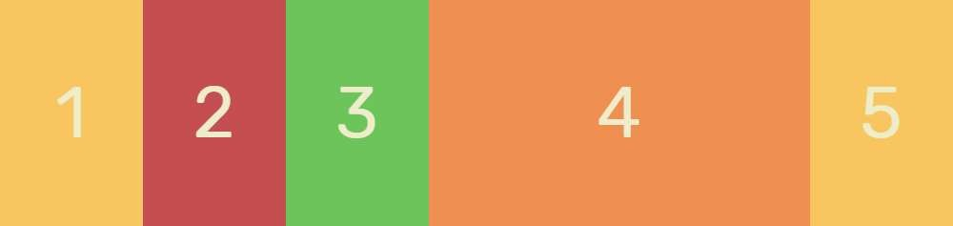
flex-grow
flex-grow: 0 | <interger>
Main Axis
120px
120px
120px
flex-grow: 1
800-(120*4) = 320px
120px
800px

Slide 29
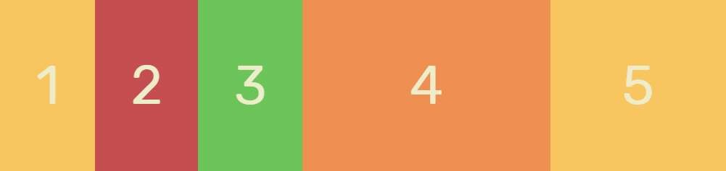
flex-grow
flex-grow: 0 | <interger>
Main Axis
flex-grow:1
flex-grow:1
flex-grow:1
flex-grow: 3
flex-grow: 2

Slide 30
Summary
Flexbox is easy and incredibly powerful.
Use display: flex; to create a flex container.
Use flex-direction if you need columns instead of rows.
Use the row-reverse or column-reverse values to flip item order.
Use justify-content to define the horizontal alignment of items.
Use align-items to define the vertical alignment of items.
Use align-self to vertically align individual items.
Use order to customize the order of individual elements.
Use flex to create flexible boxes that can stretch and shrink.

Slide 31
Examples to try out

Slide 32
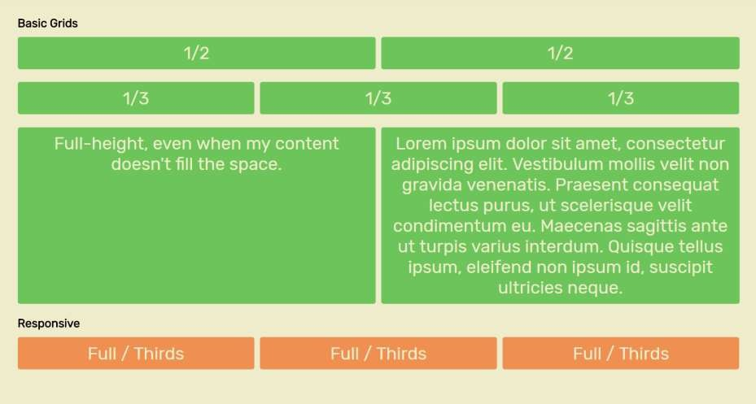
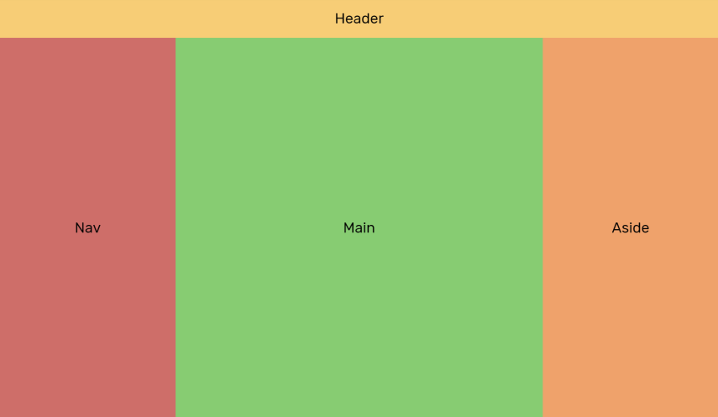
Simple Grid Systems

Slide 33
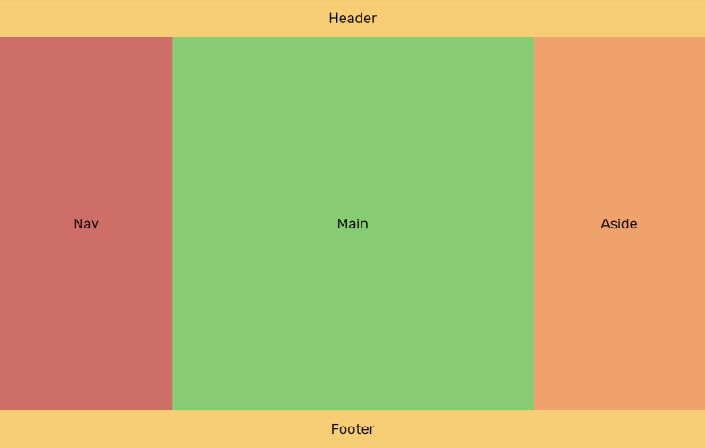
Holy Grail Layout

Slide 34
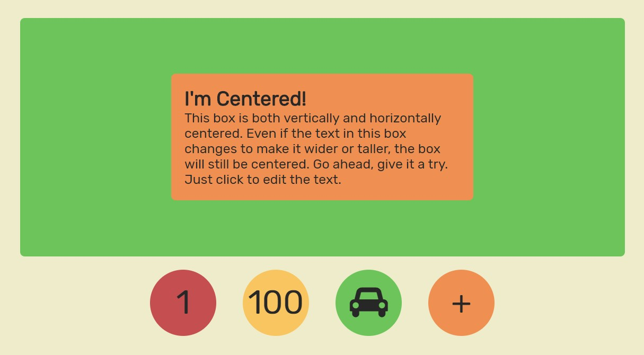
Vertical Centering

